Slide 1
Embedded SQL
Introduction
Embedded SQL without Cursor
Embedded SQL with Cursor
Dynamic SQL

Slide 2
Embedded SQL(嵌入式SQL)
The SQL standard defines embeddings of SQL in a variety of programming languages such as C, Java, and Cobol.
A language to which SQL queries are embedded is referred to as a host language(宿主语言), and the SQL structures permitted in the host language comprise embedded SQL.
EXEC SQL statement is used to identify embedded SQL request to the preprocessor
EXEC SQL <embedded SQL statement > END_EXEC
Note: this varies by language :
  the Java embedding uses:
# SQL { …. } ;
  the C embedding uses:
EXEC SQL <embedded SQL statement > ;

Slide 3
Introduction
Why Embedded SQL
  SQL is computation incomplete. (计算不完备)
  SQL is resource incomplete. (资源不完备)
Issues with Embedded SQL
  Mark the start point and end point of Embedded SQL
      EXEC SQL statement； //C
  Communication between database and programming language
      SQLCA、SQLDA
  Address the mismatching issue between SQL and host language.
      Handle result (set) with cursor
      Mapping of basic data types: SQL: Date → C: char(12)

Slide 4
Introduction
Issues with Embedded SQL
  Mark the start point and end point of Embedded SQL
      EXEC SQL <statement>； //C
  Communication between database and programming language
      SQLCA、SQLDA
  Address the mismatching issue between SQL and host lanugage.
      Handle result (set) with cursor
      Mapping of basic data types:
      SQL: Date → C: char(12)

Slide 5
Introduction
  SQLCA
    struct SQLCA
    {
    char sqlcaid[8];
    long sqlcabc;
    long sqlcode;
    struct
    {
    unsigned short sqlerrml;
    char sqlerrmc[70];
    } sqlerrm;
    char sqlerrp[8];
    long sqlerrd[6];
    char sqlwarn[8];
    char sqlext[8];
    };
Notes:
sqlcaid: 字符串字段, 被初始为sqlca, 用于标识SQL通信区。
sqlabc: 整型字段, 用于保留SQL通信区的字节长度。
sqlcode: 整型字段, 用于保留最近执行的SQL语句的状态:
= 0 表示该SQL语句执行成功, 没有发生错误和异常。
> 0 表示执行了该SQL语句, 但有一异常。
< 0 表示由于DB、系统、网络或程序有错误, ORACLE 未执行该语句。如出现这类错误, 当前事务一般回退。
sqlerrm: 是个子结构, 含有两个元素。
sqlerrmc: 字符串字段, 保存与sqlcode对应的正文, 用SQLGLM()函数引用。当sqlcode < 0时, 该正文表示当前SQL的执行情况; 如sqlcode = 0时, 该正文表示前面SQL的执行情况。
sqlerrml: 整字段, 上述正文长度。
sqlerrd: 长整数组, 6个元素, 用了2个。
sqlerrd[2]: 保存当前SQL语句处理的行数。但若当前SQL失败, 则无定义; 若在数组操作中出错, 则停于出错行, 这时给出成功处理的行数; OPEN执行后, 清为0, FECTH 后增值（原有值+上本次fetch的行数）; EXECUTE、INSERT、UPDATE、SELETE和SELECT后, 为成功处理的行数。
sqlerrd[4]: 指出语句中出错的位移, 首字符位移为0。
sqlwarn: 字符数组, 8个元素, 用了5个。
sqlwarn[0]: 如为空, 无警告; 如为"W", 有警告;
sqlwarn[1]: 如为 "W", 表示宿主变量宽度不够, 返回字符数据被截断; 对数字型数据截断无警告。为了决定何字段被截断及截了多少, 查相应指示变量, 该指示变量的正值是列的原长。
sqlwarn[3]: 如为"W", 表示查询选择表中的列数不等于SELECT或FECTH的INTO子句的宿主变量数, 返回为两者中少者。
sqlwarn[4]: 如为"W", 表示DELETE或UPDATE语句无WHERE限制条件, 提醒用户小心。
sqlwarn[5]: 如为"W", 表示EXEC SQL CREATE {PROCEDURE | FUNCTION | PACKAGE | PACKAGE BODY}语句由于PL/SQL编译而失败

Slide 6
Introduction
  SQLDA
      struct SQLDA
      {
      long N; /* Descriptor size in number of entries */
      char **V; /*Ptr to Arr of addresses of main variables */
      long *L; /* Ptr to Arr of lengths of buffers */
      short *T; /* Ptr to Arr of types of buffers */
      short **I; /* Ptr to Arr of addresses of indicator vars */
      long F; /* Number of variables found by DESCRIBE */
      char **S; /* Ptr to Arr of variable name pointers */
      short *M; /* Ptr to Arr of max lengths of var. names */
      short *C; /* Ptr to Arr of current lengths of var. names */
      char **X; /* Ptr to Arr of ind. var. name pointers */
      short *Y; /* Ptr to Arr of max lengths of ind. var. names */
      short *Z; /* Ptr to Arr of cur lengths of ind. var. names */
      };
Notes:
SQLDA结构成员作用描述：
名称 描述
N SELECT-LIST列或占位符的最大数量，执行DESCRIBE前必须执行SQLSQLDAAlloc()函数给N进行赋值，设定描述数组的维数，其决定了描述字结构成员数组的最大元素个数。在DESCRIBE命令后，必须将存储在F中的变量真实个数赋值给N。
V 是一个指向一个地址数组的指针，在该数组中存储SELECT-LIST列值或绑定变量的值。当使用SQLSQLDAAlloc函数时，系统给V[0]到V[n-]赋值为0。在使用select descriptors时，必须在FETCH语句前，给V指针数组分配内存空间，应为下列语句要用到两种描述字具体的值：
EXEC SQL FETCH ... USING ‘select descriptors’
对于bind descriptors,必须在OPEN语句前分配空间
EXEC SQL OPEN ... USING ‘bind descriptors’
L L是一个指向存放select-list或bind-variable变量值长度数组的指针。对于selectdescriptors，DESCRIBE SELECT LIST语句设置数组中各元素的值，对不在select-list的对应长度设置成该类型的可的定义的最大长度。在FETCH语句前，用户可能需要重新修改变量长度，比如为了显示原因，需要将NUMBER类型数据存储到C语言char[]类型，就需要通过SQLNumberPrecV6()函数得到NUMBER长度，然后转换成字符串后的真实长度。对于bind descriptors，用户必须在OPEN语句前，给数组成员赋对应V变量成员长度的值。因为Oracle间接的通过使用存储在V[i]变量的地址访问数据区域，如果不指定L[i]变量，就不能得到V[i]的存储数据的长度，也就不能得到或给V[i]指定的数据区域赋值。如果用户需要更改V[i]指定数据区域的长度，只需要简单更改L[i]的值即可。
T T时指向一个数组的指针，在这个数组中存放这select-list或者bind-variable的数据类型。这个成员决定了Oracle数据存储到V数组中时如何进行转换。对于select descriptors，DESCRIBE SELECT LIST语句设置数据类型数组值为Oracle内部数据类型（char ,number或date等）。在进行FETCH前，用户可能需要重新根改此数组某元素的值，因为Oracle内部数据类型很难被C语言所采用。通常为了对select-list对应的select descriptors数据进行显示，需要将数据类型转换成varchar2或STRING类型。T[i]的高位用来指示其对应的select-list列值的“NULL/NOT NULL”状态。在使用OPEN或FETCH语句前，需要调用SQLColumnNullCheck()接受T[i]数据类型值，并清空高位NULL/NOT NULL状态。对于bind descriptors，DESCRIBE BIND VARIABLES设置数据类型数组的各元素值为0。用户必须在OPEN命令前设置各输入宿主变量的数据类型。变量类型值采用Oracle外部数据类型描述。通常，绑定变量值存储在字符串数组中，其对应的T[i]就设置为1(Varchar2)或者5(STRING)。
I 这是一个指向存储指示变量值数组的指针。对于select descriptors，在FETCH语句前必须设置I数组各元素所指向的地址。
EXEC SQL FETCH ... USING ‘select descriptor’
如果第i个select-list对应列值为空，则I[i]值为-1 否则是个>=0的整数。
对于bind descriptors，必须在OPEN语句前设置I数组各变量的值。
EXEC SQL OPEN ... USING ‘bind descriptor’
F 存放通过DESCRIBE语句得到的select-list或占位符的真实数目，如果经过DESCRIBE语句后F小于零表示DESCRIBE语句发现的select-list数目或占位符数目比分配描述符时指定的最大数据数目N大，例如，如果设置N=10但DESCRIBE发现select-list的数目是11个，那么F将被设置成-11，这允许用户根据此值重新调用
SQLSQLDAAlloc函数分配大的描述符存储区域。
S 指向一个数组的指针，该数组存储了select-list或占位符的名字。
M 指向一个数组的指针，该数组存储了select-list或占位符名字的最大长度。
C 指向一个数组的指针，该数组存储了select-list或占位符名字的当前长度。
X 指向一个存储指示变量名字数组的指针。
Y 指向一个存储指示变量名字最大长度数组的指针。
Z 指向一个存储指示变量名称当前长度数组的指针。

Slide 7
Banking Example
branch (branch_name, branch_city, assets)
customer (customer_name, customer_street, customer_city)
account (account_number, branch_name, balance)
depositor (customer_name, account_number)
loan (loan_number, branch_name, amount)
borrower (customer_name, loan_number)

Slide 8
Embedded SQL without cursor
insert、delete、update、select(single record)
main( )
{ EXEC SQL INCLUDE SQLCA; //声明段开始
EXEC SQL BEGIN DECLARE SECTION;
char account_no [11]; //host variables(宿主变量)声明
char branch_name [16];
int balance;
EXEC SQL END DECLARE SECTION;//声明段结束
EXEC SQL CONNECT TO bank_db USER Adam Using Eve;
scanf (“%s %s %d”, account_no, branch_name, balance);
EXEC SQL insert into account
values (:account_no, :branch_name, :balance);
If (SQLCA.sqlcode ! = 0) printf ( “Error!\n”);
else printf (“Success!\n”);
}

Slide 9
Embedded SQL without cursor(delete)
main( )
{ EXEC SQL INCLUDE SQLCA; //声明段开始
EXEC SQL BEGIN DECLARE SECTION;
char account_no [11]; //host variables(宿主变量)声明
EXEC SQL END DECLARE SECTION;//声明段结束
EXEC SQL CONNECT TO bank_db USER Adam Using Eve;
scanf (“%s”, account_no);
EXEC SQL delete from account where
account_number=:account_no;
If (SQLCA.sqlcode ! = 0) printf ( “Error!\n”);
else printf (“Success!\n”);
}

Slide 10
Embedded SQL without cursor(update)
main( )
{ EXEC SQL INCLUDE SQLCA; //声明段开始
EXEC SQL BEGIN DECLARE SECTION;
char account_no [11]; //host variables(宿主变量)声明
int balance;
EXEC SQL END DECLARE SECTION;//声明段结束
EXEC SQL CONNECT TO bank_db USER Adam Using Eve;
scanf (“%s %d”, account_no, balance);
EXEC SQL update account
set balance= balance+:balance
where account_number = :account_no;
If (SQLCA sqlcode ! = 0) printf ( “Error!\n”);
else printf (“Success!\n”);
}

Slide 11
Embedded SQL without cursor
(select single record)
main( )
{ EXEC SQL INCLUDE SQLCA; //声明段开始
EXEC SQL BEGIN DECLARE SECTION;
char account_no [11]; //host variables(宿主变量)声明
int balance;
EXEC SQL END DECLARE SECTION;//声明段结束
EXEC SQL CONNECT TO bank_db USER Adam Using Eve;
scanf (“%s ”, account_no);
EXEC SQL select balance into :balance
from account
where account_number = :account_no;
If (SQLCA sqlcode ! = 0) printf ( “Error!\n”);
else printf (“balance= %d \n”, balance);
}

Slide 12
Embedded SQL without cursor
(select single record)
main( )
{ EXEC SQL INCLUDE SQLCA; //声明段开始
EXEC SQL BEGIN DECLARE SECTION;
char account_no [11]; //host variables(宿主变量)声明
int balance;
int mask; //mask指示变量
EXEC SQL END DECLARE SECTION;//声明段结束
EXEC SQL CONNECT TO bank_db USER Adam Using Eve;
scanf (“%s %d”, account_no, balance);
EXEC SQL select balance into :balance:mask // 指示变量=0 正常
from account //指示变量<0 NULL
where account_number = :account_no; //指示变量 >0 截断
If (SQLCA sqlcode ! = 0) printf ( “Error!\n”);
else if (mask ==0) printf (“balance= %d \n”, balance);
else printf(“balance is NULL!\n”)
}

Slide 13
Embedded SQL with cursor
(select multiple records)
main( )
{ EXEC SQL INCLUDE SQLCA;
EXEC SQL BEGIN DECLARE SECTION;
char customer_name[21];
char account_no [11];
int balance;
EXEC SQL END DECLARE SECTION;
EXEC SQL CONNECT TO bank_db USER Adam Using Eve;
EXEC SQL DECLARE account_cursor CURSOR for
select account_number, balance
from depositor natural join account
where depositor.customer_name = : customer_name;
//… more code on next page

Slide 14
Embedded SQL with cursor
(select multiple records)
//continue…
scanf (“%s”, customer_name);
EXEC SQL open account_cursor;
for (; ;)
{ EXEC SQL fetch account_cursor into :account_no, :balance;
if (SQLCA.sqlcode!=0)
break;
printf( “%s %d \ n”, account_no, balance);
}
EXEC SQL close account_cursor;
}

Slide 15
Delete or update current record
where current of 游标名
//continue…
scanf (“%s”, customer_name);
EXEC SQL open account_cursor;
for (; ;)
{ EXEC SQL fetch account_cursor into :account_no, :balance;
if (SQLCA.sqlcode!=0)
break;
if (balance <1000)
EXEC SQL update account set balance=balance*1.05
where current of account_cursor;
else
EXEC SQL update account set balance=balance*1.06
where current of account_cursor;
}
EXEC SQL close account_cursor;
}

Slide 16
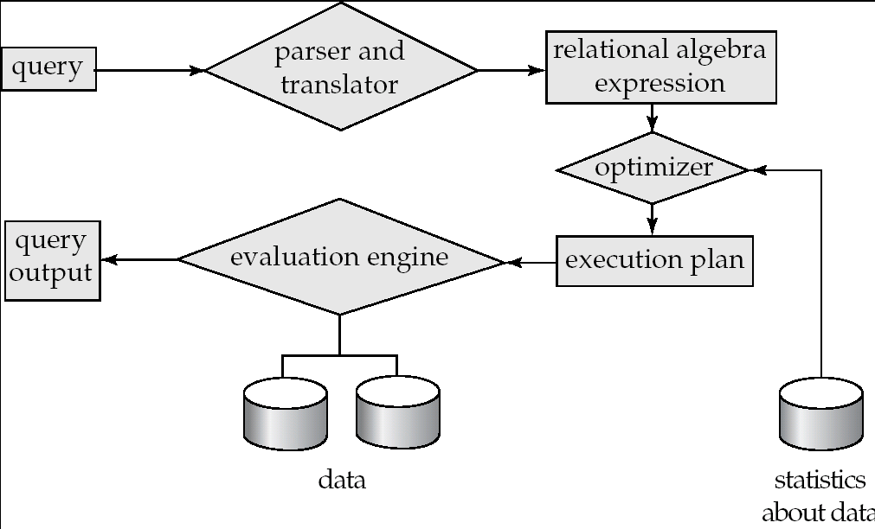
Basic Steps in Query Processing
1. Parsing and translation
2. Optimization
3. Evaluation

Slide 17
Dynamic SQL
Allows programs to construct and submit SQL queries at run time.
Example of the use of dynamic SQL from within a C program.
char * sqlprog = “update account
set balance = balance * 1.05
where account_number = ?”
EXEC SQL prepare dynprog from :sqlprog;
char account [10] = “A-101”;
EXEC SQL execute dynprog using :account;
The dynamic SQL program contains a ?, which is a place holder (占位符) for a value that is provided when the SQL program is executed.

Slide 18
Dynamic SQL
Static Embedded SQL and Dynamic Embedded SQL
  Static： Embedded SQL statements( include relation names and attribute names) are hard coded in program.
  Dynamic：Embedded SQL statements are built at run time
Two execution modes of Dynamic Embedded SQL
  EXECUTE IMMEDIATE
  PREPARE / EXECUTE

Slide 19
Dynamic SQL- EXECUTE IMMEDIATE
//delete from %s [where %s];
EXEC SQL begin declare section;
char statement[256];
EXEC SQL end declare section;
char table_name[32], condition[128];
gets (table_name);
gets( condition);
if (strlen (condition)>0)
sprintf (statement, “delete from %s where %s”, table_name, condition);
else
sprintf (statement, “delete from%S”, table_name);
EXEC SQL EXECUTE IMMEDIATE :statement;

Slide 20
Dynamic SQL- PREPARE/EXECUTE
// update %s set %s=? where %s=?
// variables：statement, new_value, search_val;
// table_name, update_column, search_column;
gets (table_name); gets(update_column); gets (search_column);
sprintf (statement, “update %s set %s=? where %s=?”,
table_name, update_column, search_column)
EXEC SQL PREPARE mystmt FROM :statement;
//check sq1 state
for (; ;){
scanf ( “%d %d”, &new_value, &search_value);
EXEC SQL EXECUTE mystmt USING : new_value, : search_value;
//check sq1 state
}

Slide 21
SQL Server: nsqlprep.exe
Embedded SQL Statements → Sqlakw32. dll
→ Ntwdblib. dll
nsqlprep ESQL_File
/SQLACCESS
/DB server_name.database_name
/PASS login.password
  ESQL_File: file of Embedded SQL C program;
  /SQLACCESS: create stored procedures for static embedded SQL statements;
  /DB server_name.database_name: names of the server and the database;
  /PASS login.password: user/password

